Slide 1

1.ARMA v ARIMA Candidate Models
U.S. & California
COVID-19
Jaclyn Coate
Josh Eysenbach
Final Presentation
Summer 2020 Time Series 6373

Slide 2
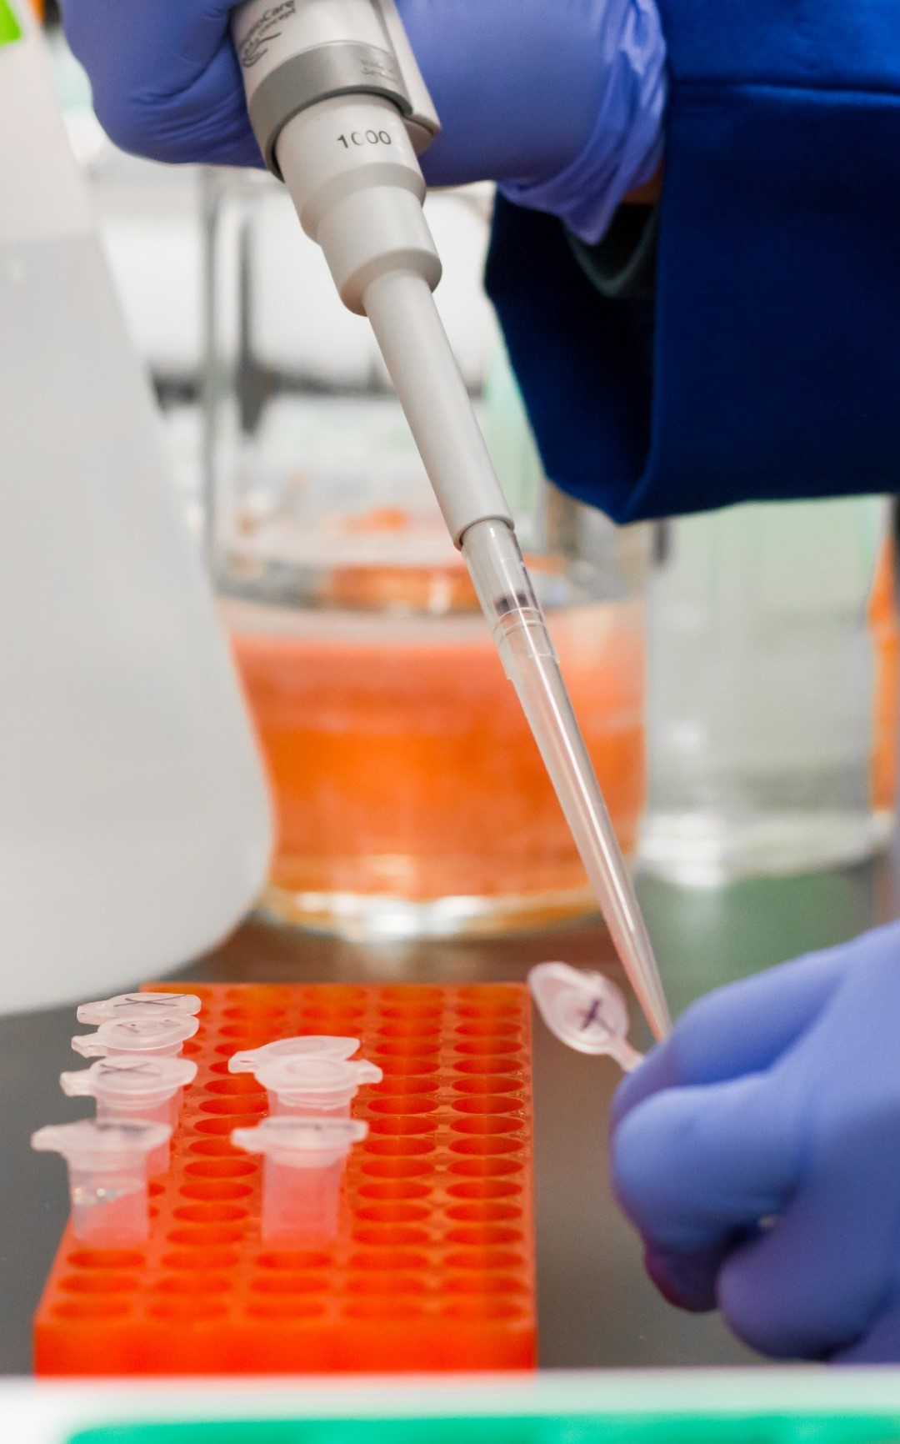
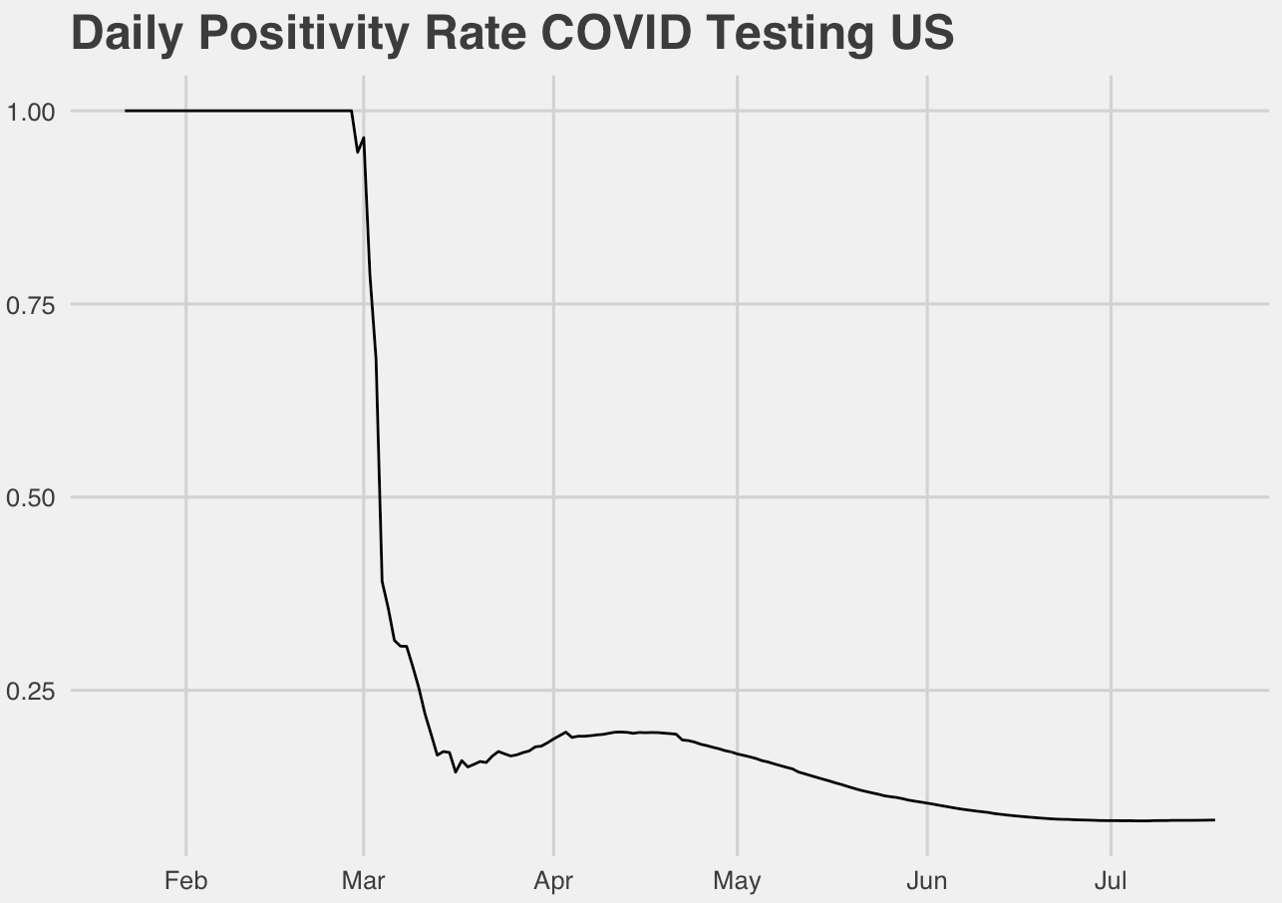
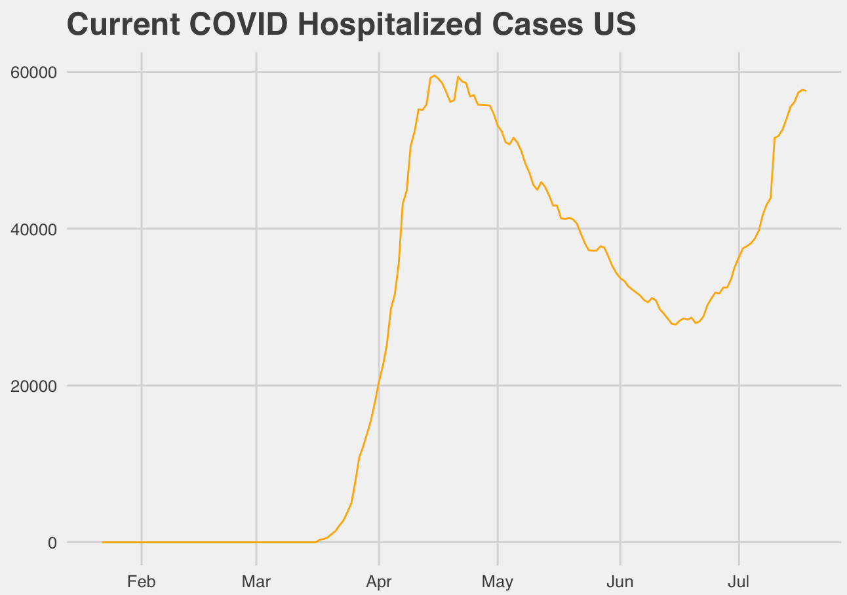
Overview
Presenters
Josh Eysenbach
Jaclyn Coate
Data Set
The COVID Tracking Project
California data: ca.gov
Severity Measurement
Positive Percent
Death Rate
Currently Hospitalized

Slide 3
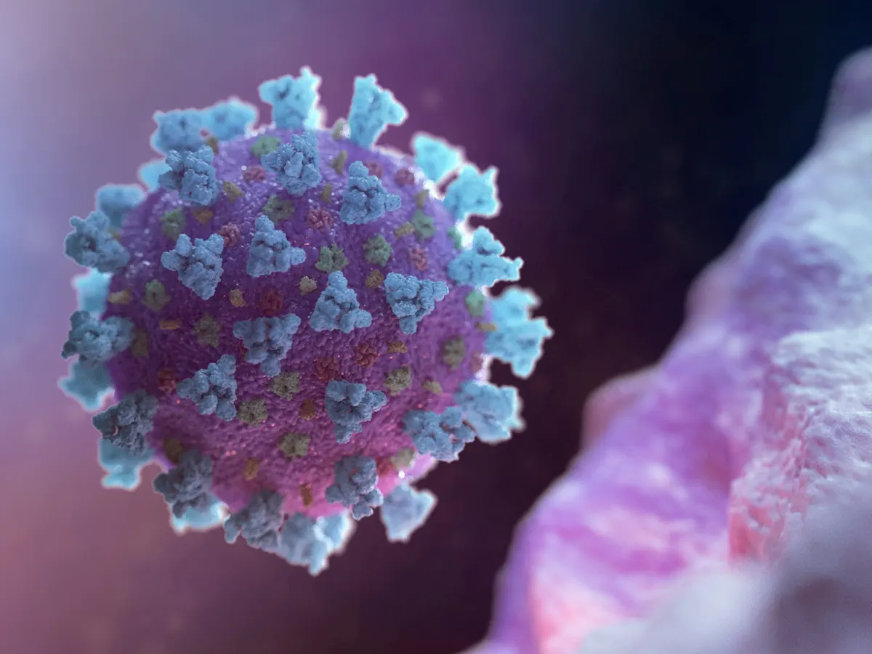
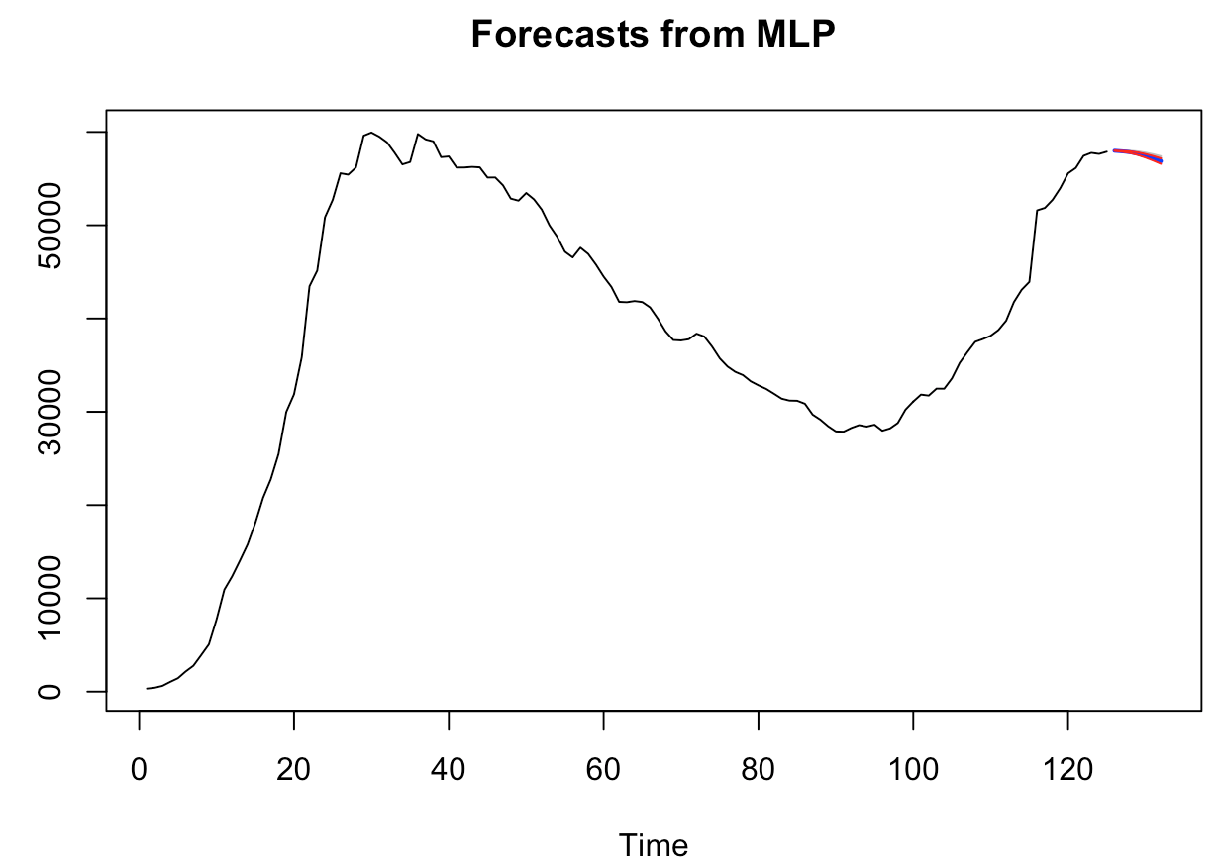
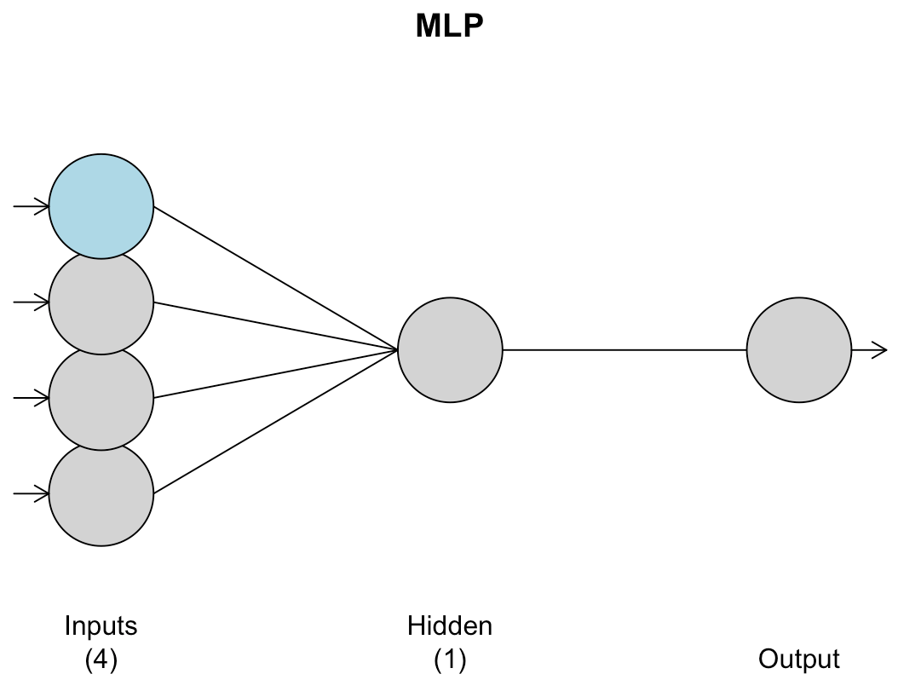
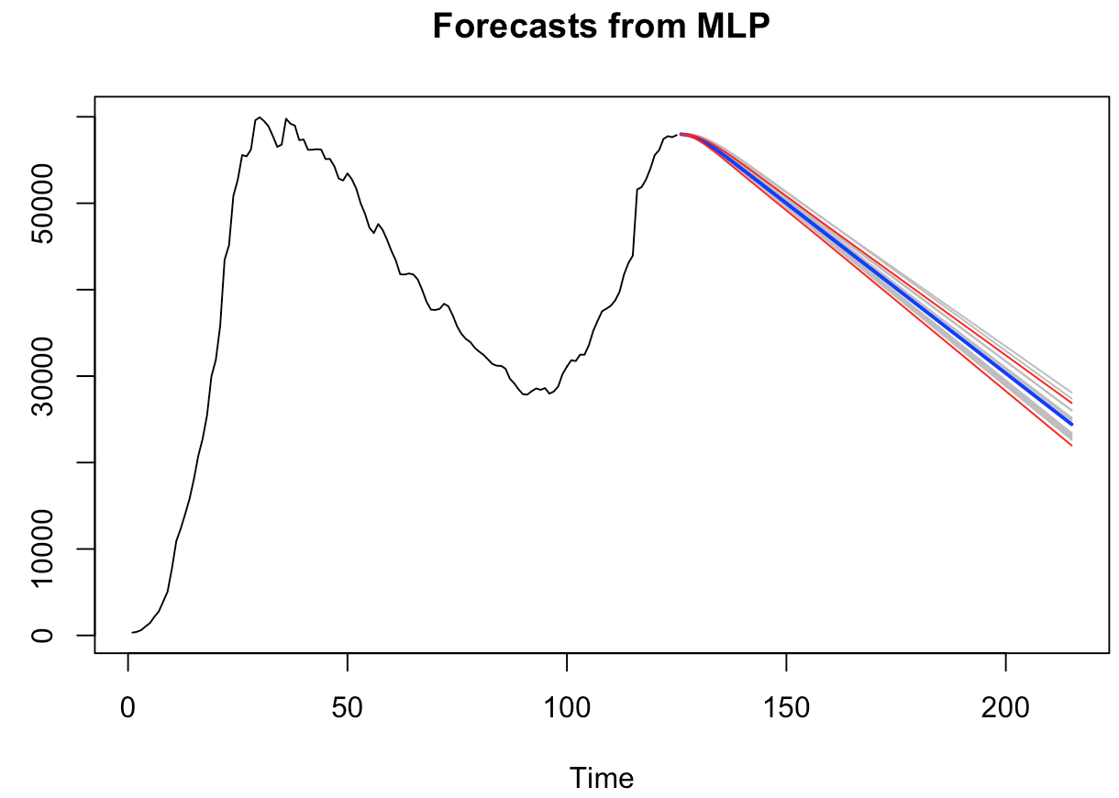
Us Univariate MLP MOdel analysis
Hyper tuned parameters neural network model
Windowed ASE: 8,697,552

Slide 4

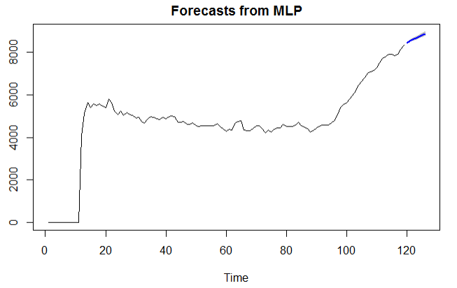
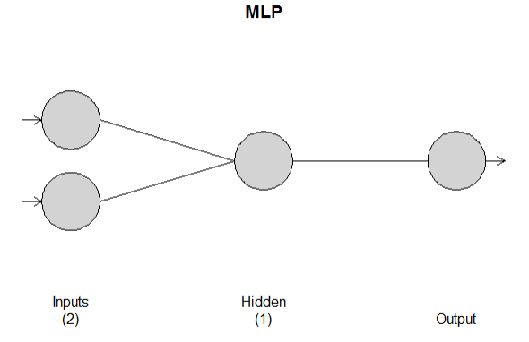
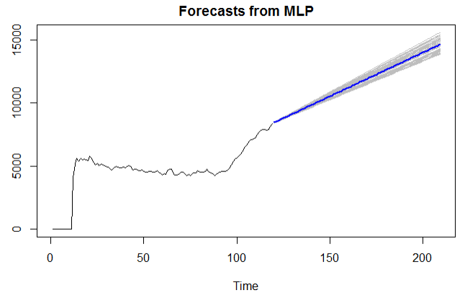
CA Univariate MLP MOdel analysis
Hyper tuned parameters neural network model
Windowed ASE: 92,395

Slide 5
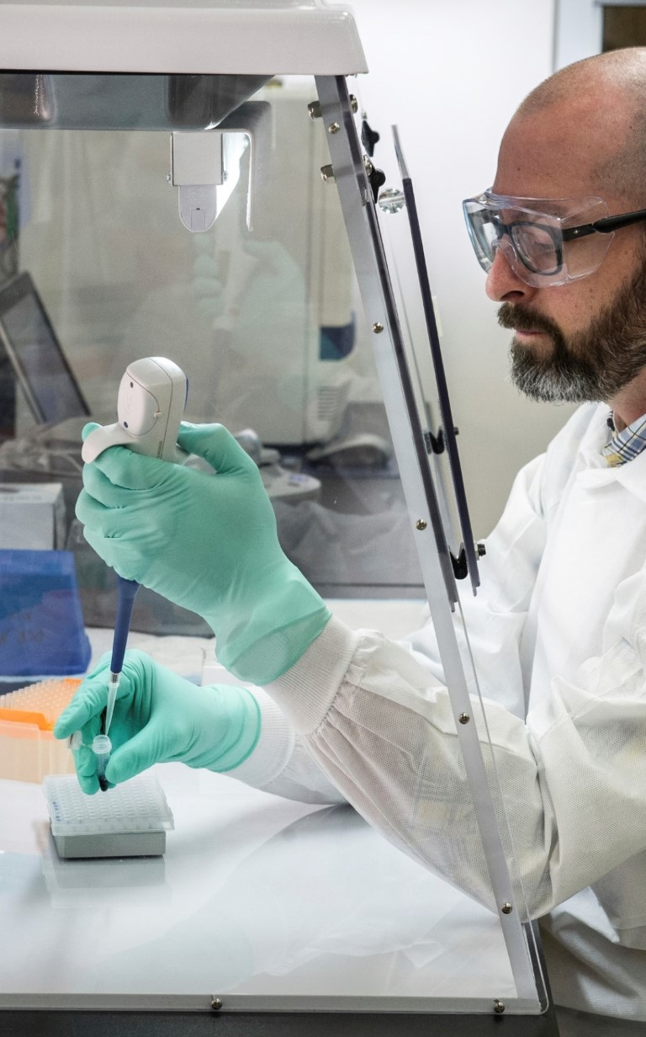

Variable analysis and additions
US Policy Changes
Travel
Health recommendations
CA Policy Changes
Travel
Mask requirements
Business / School Closures

Slide 6
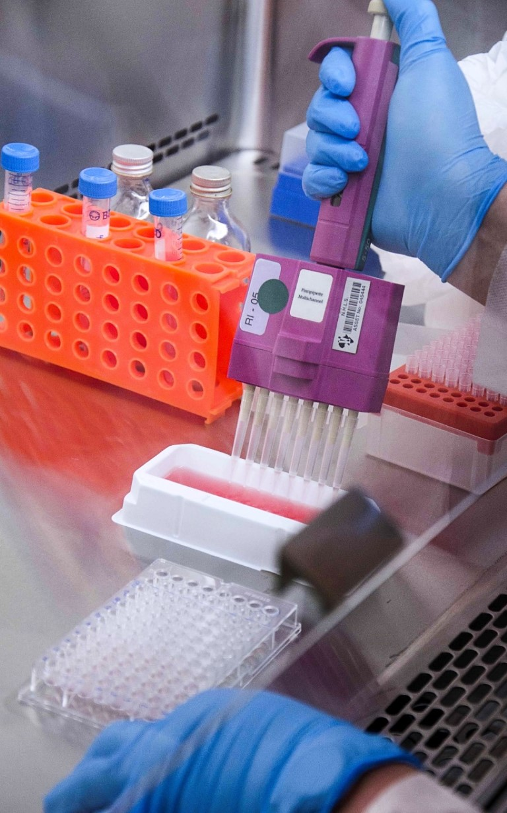
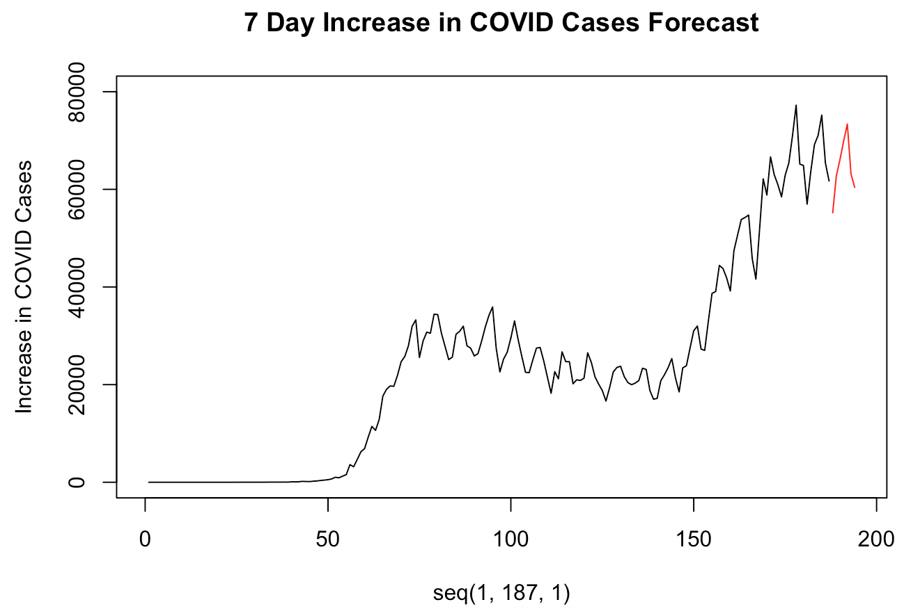
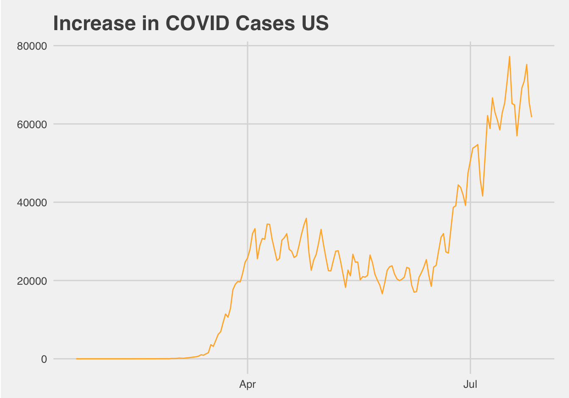
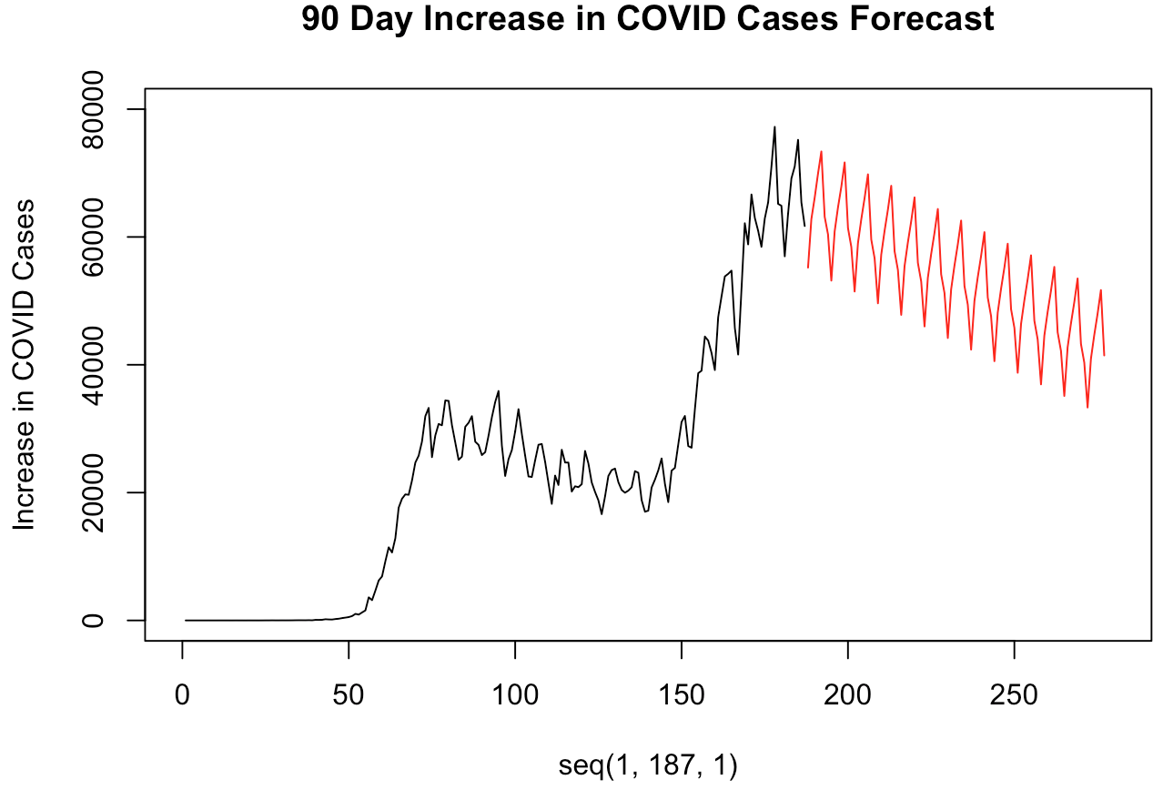
United States
Regressor variable analysis
MLR
MLP

Slide 7
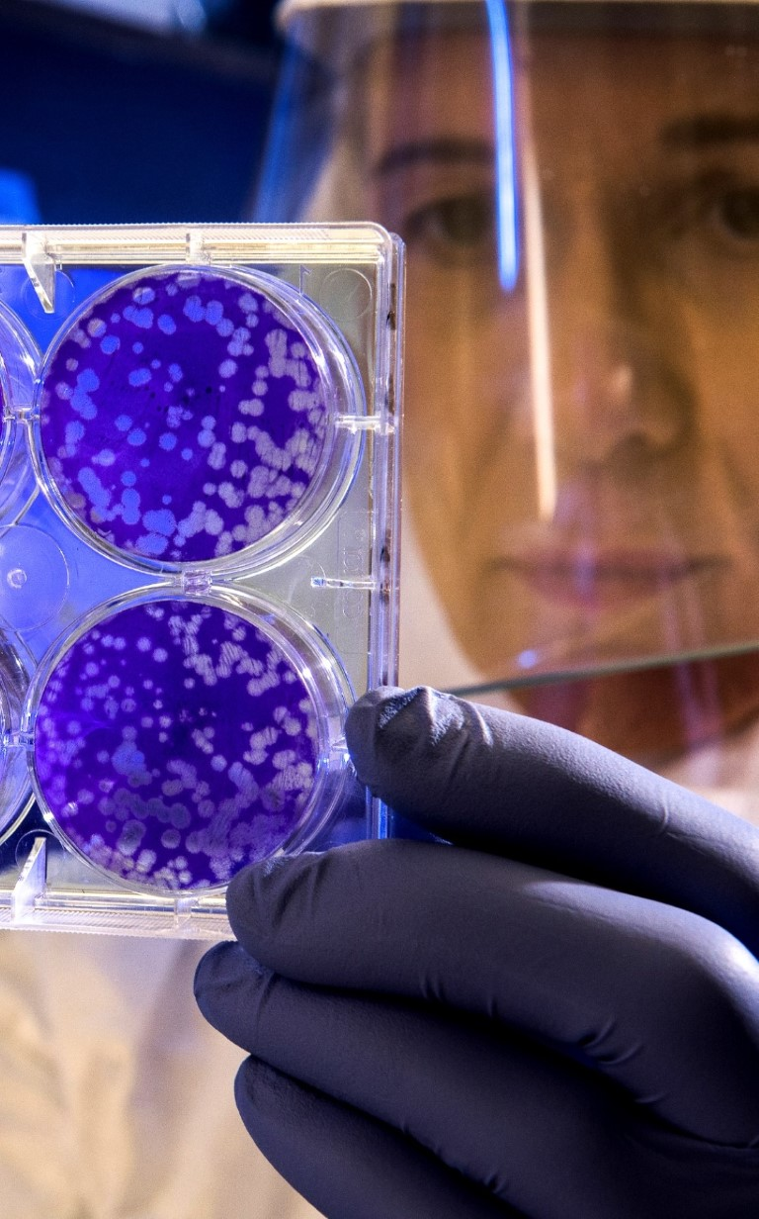
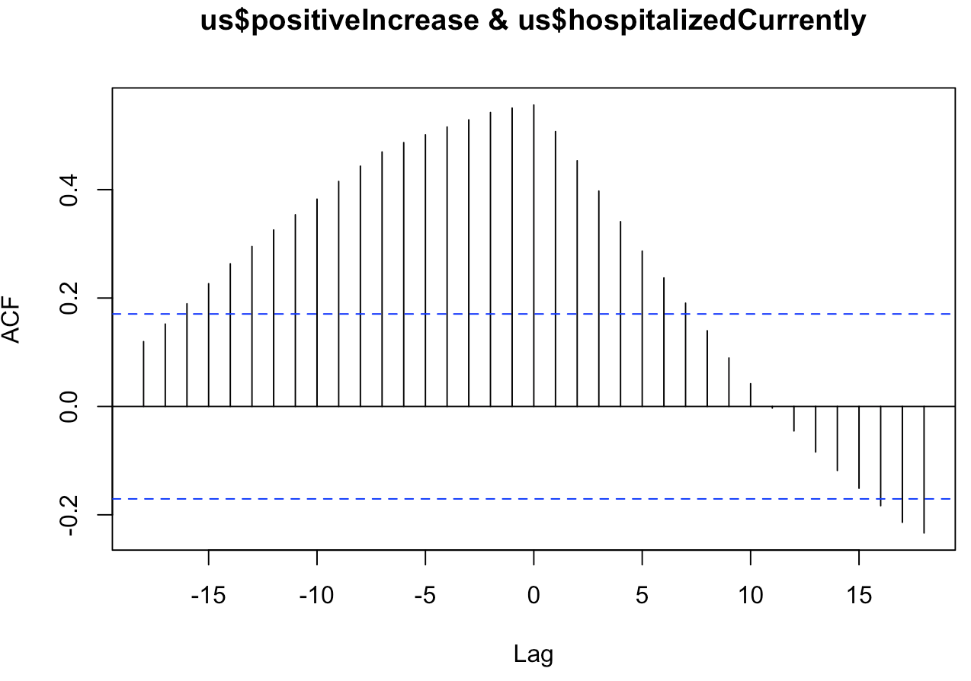
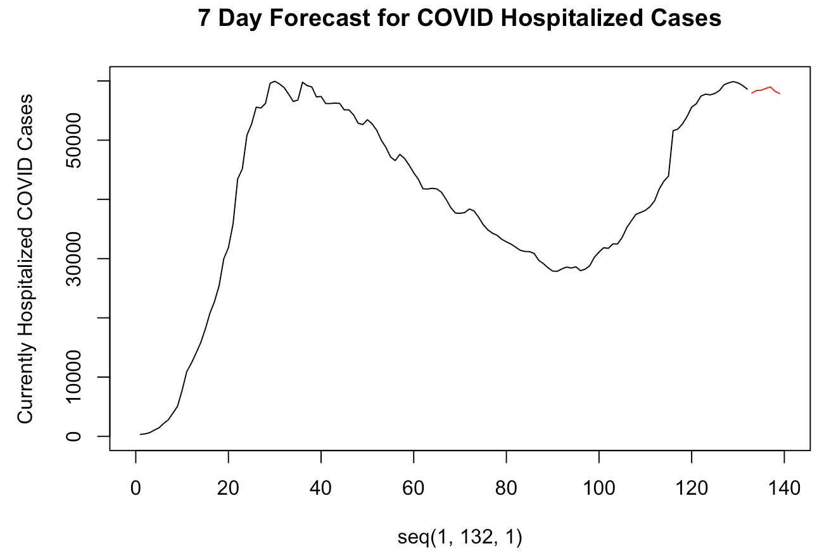
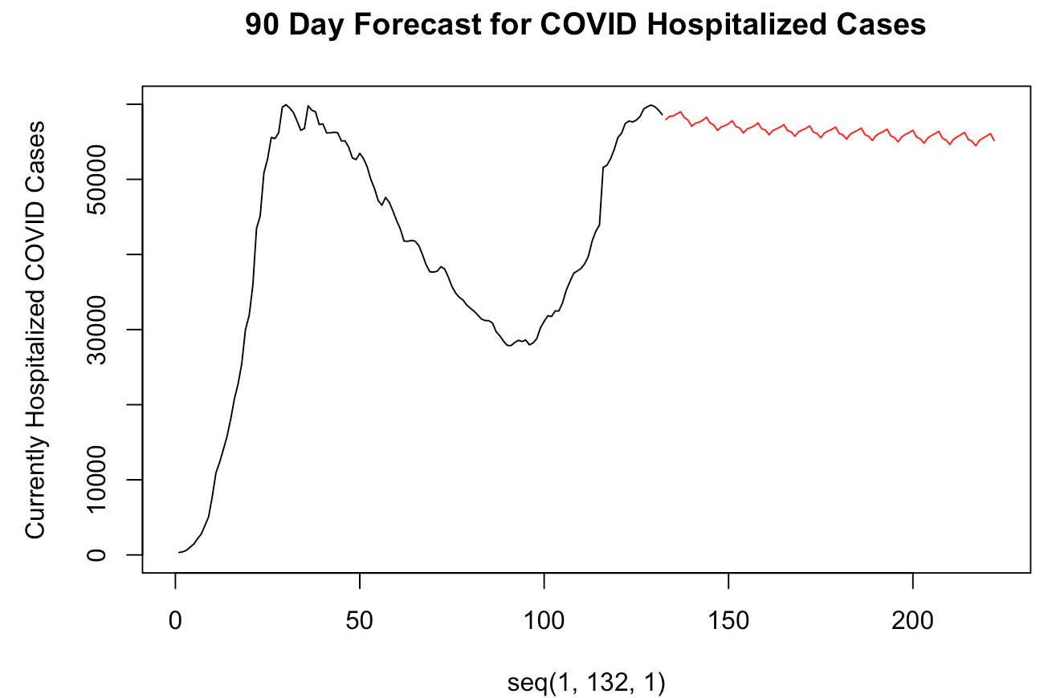
United states
MLR
AIC: 2184.712
7-Day ASE
631,469.8
90-Day ASE
567,209,810
MLR w/ trend
AIC: 2186.678
7-Day ASE
1,449,565
90-Day ASE
2,867,623,021

Slide 8
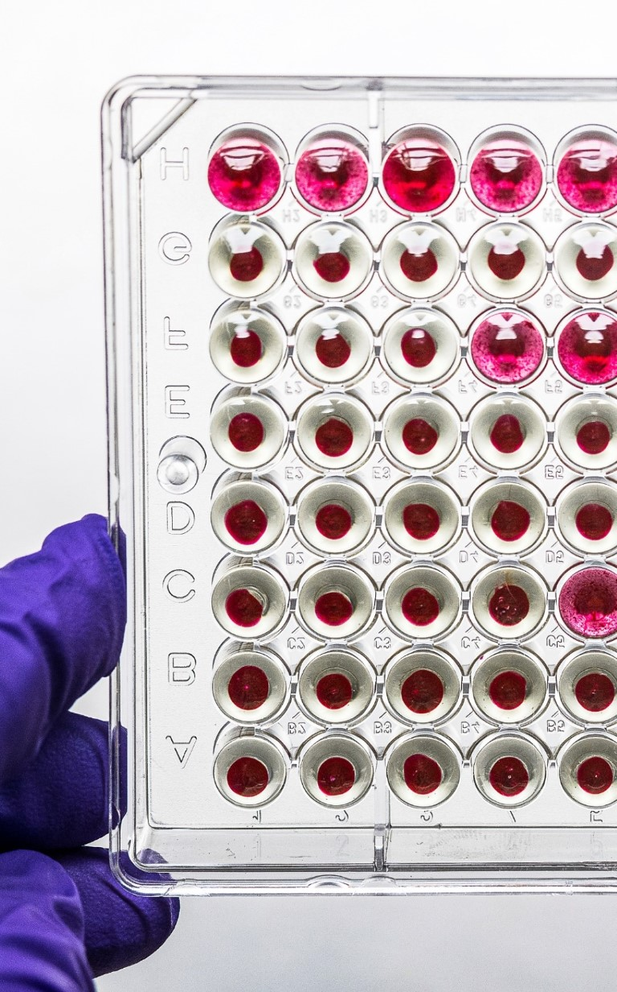
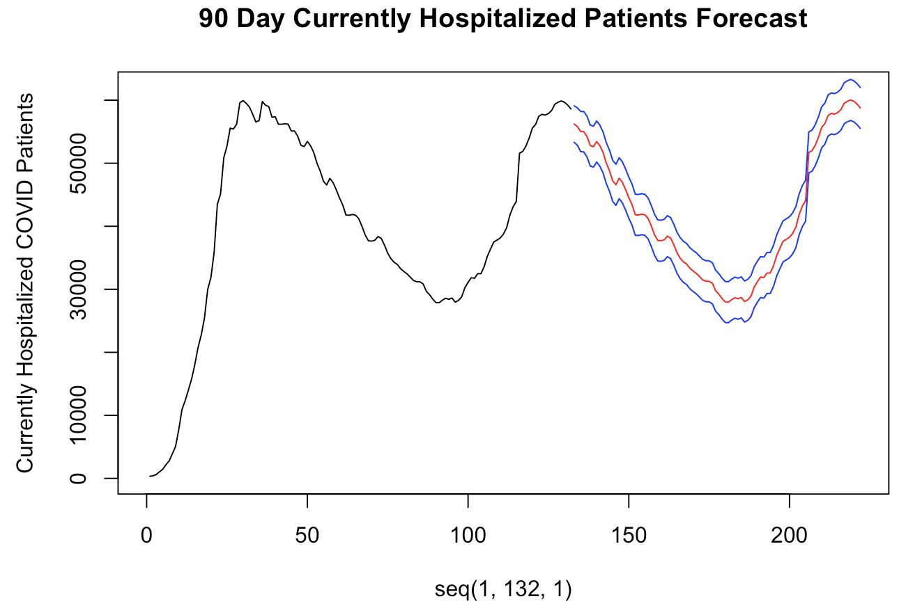
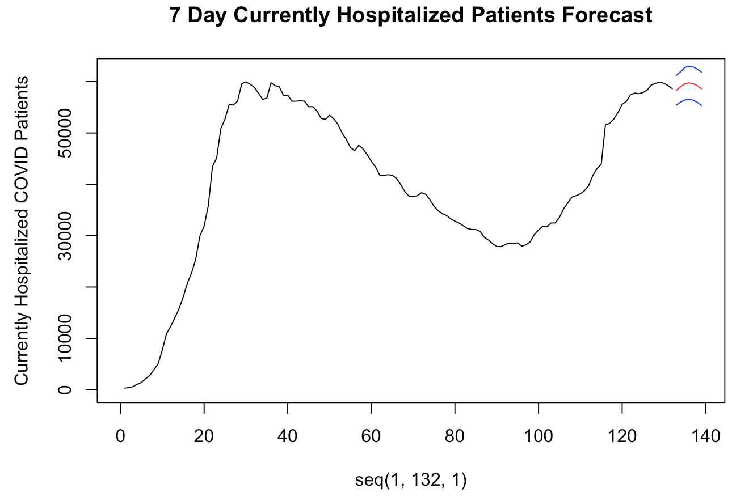
United states
Vector autoregression model
7-Day ASE
25,178.55
90-Day ASE
10,791.59

Slide 9
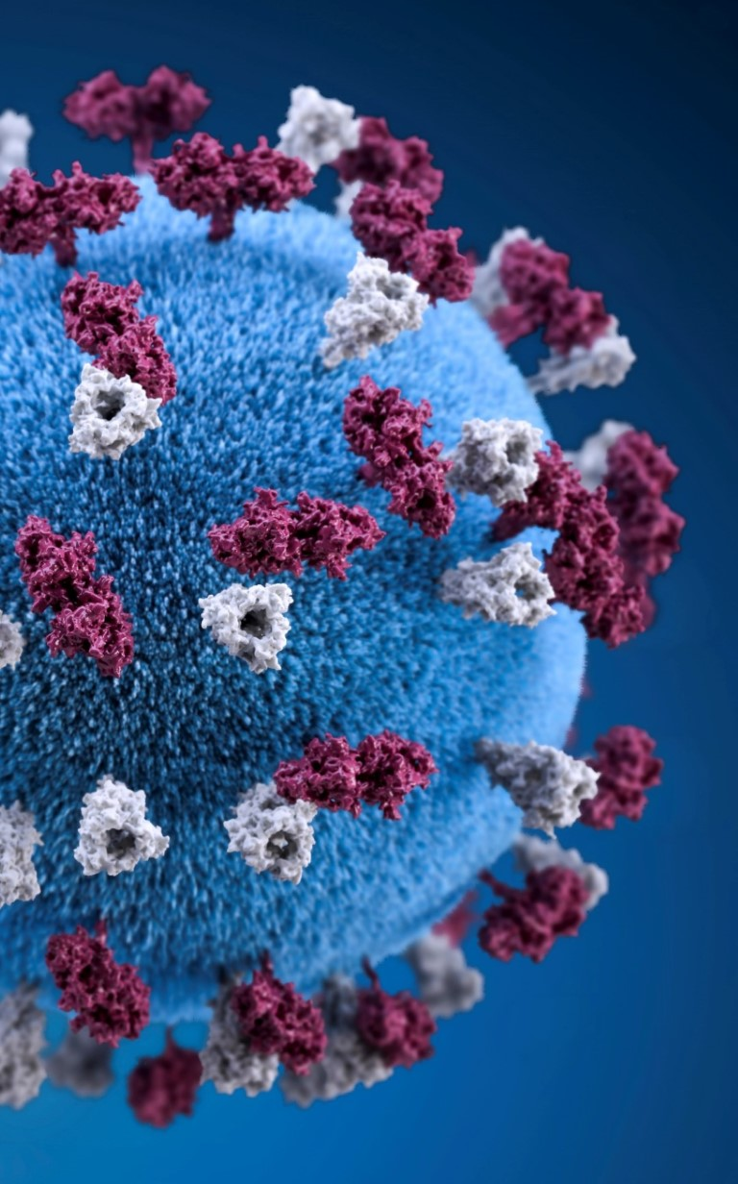
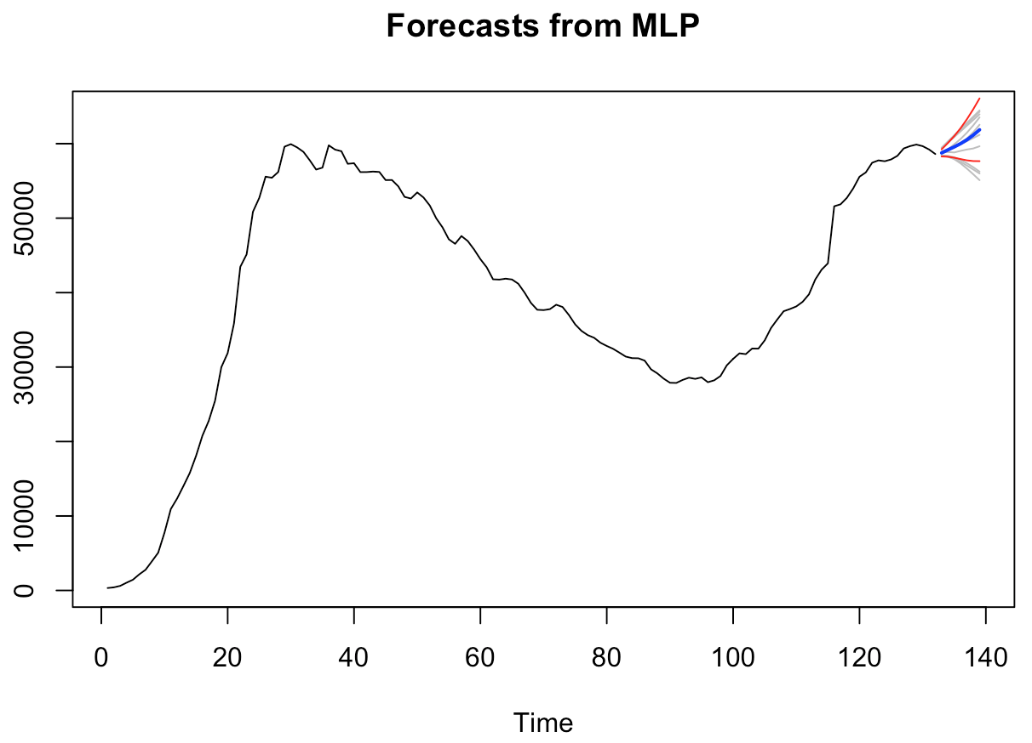
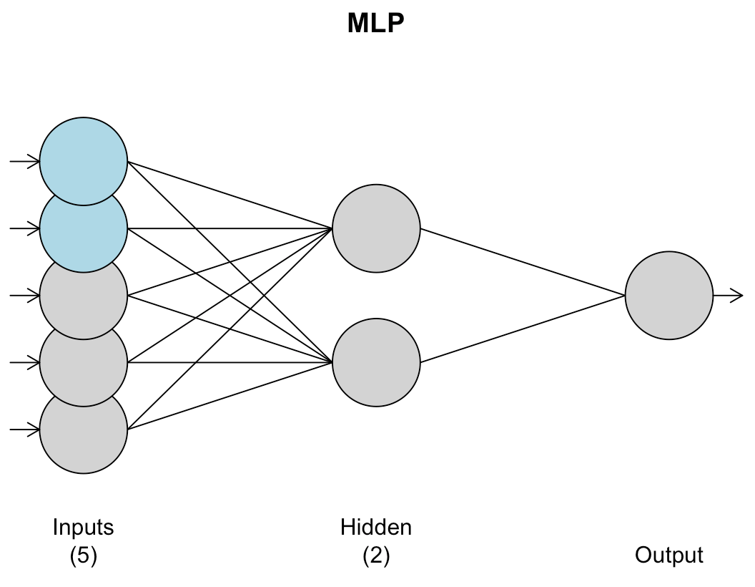
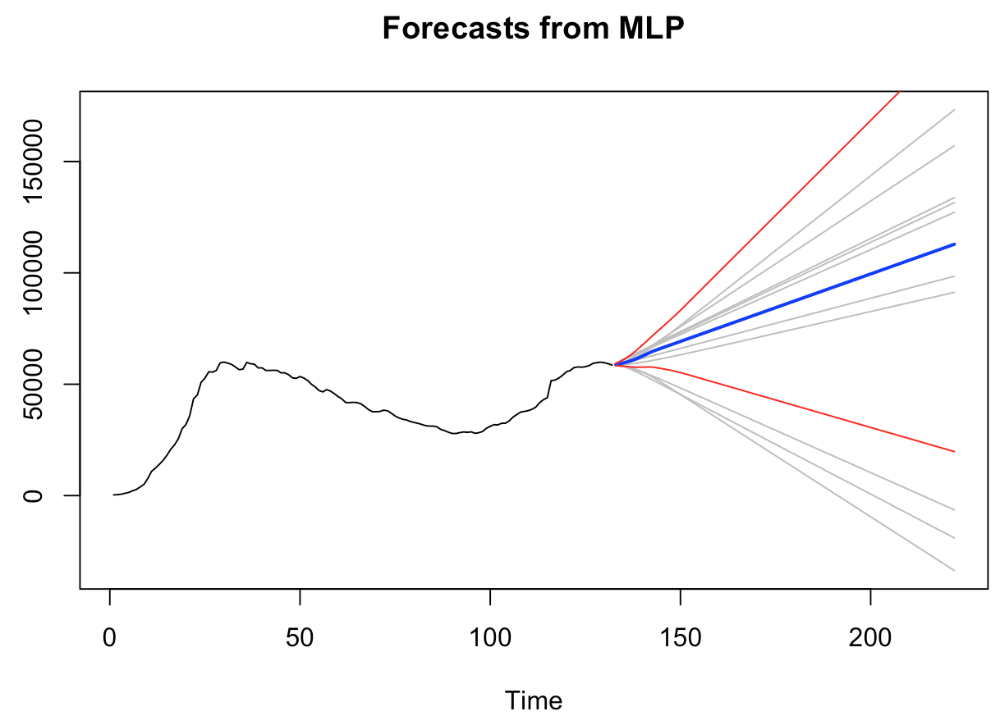
United states
Hyper parameter tuned MLP model

Slide 10
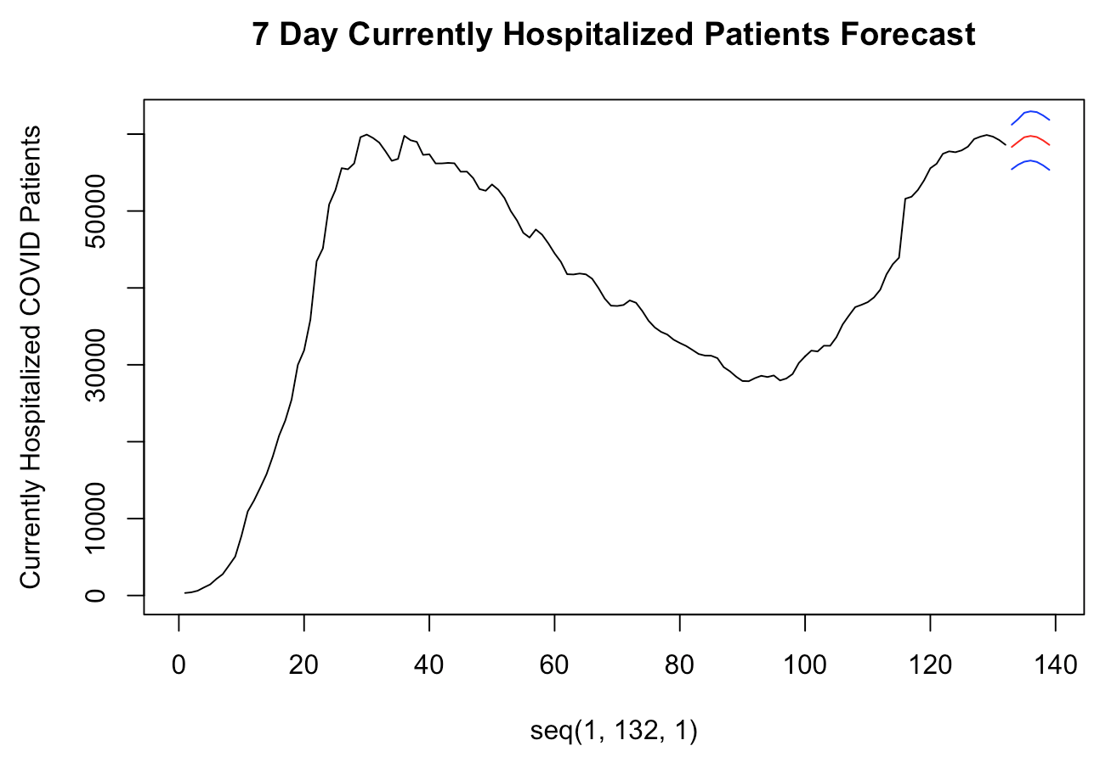
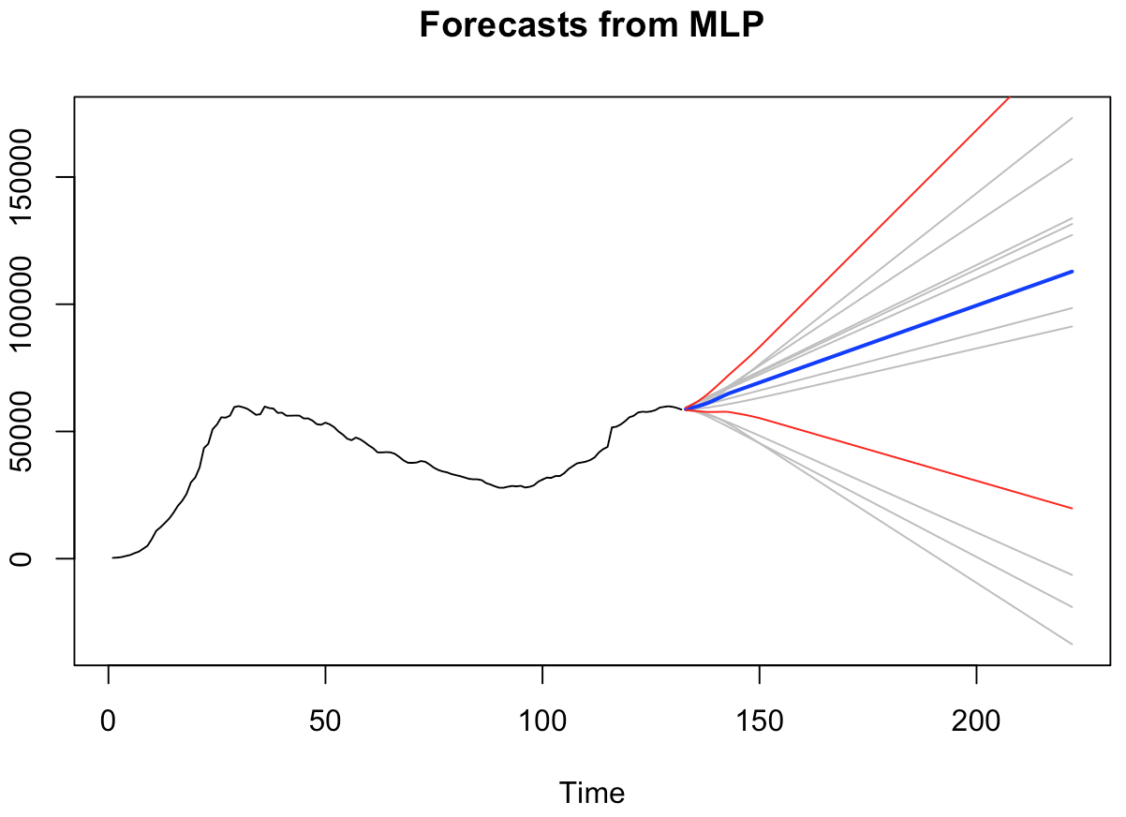
United states: final model analysis
7-Day Forecast
Univariate MLP: 12,177,586
Multivariate VAR: 5,178.55
90-Day Forecast
Multivariate MLP: 13,970,241

Slide 11
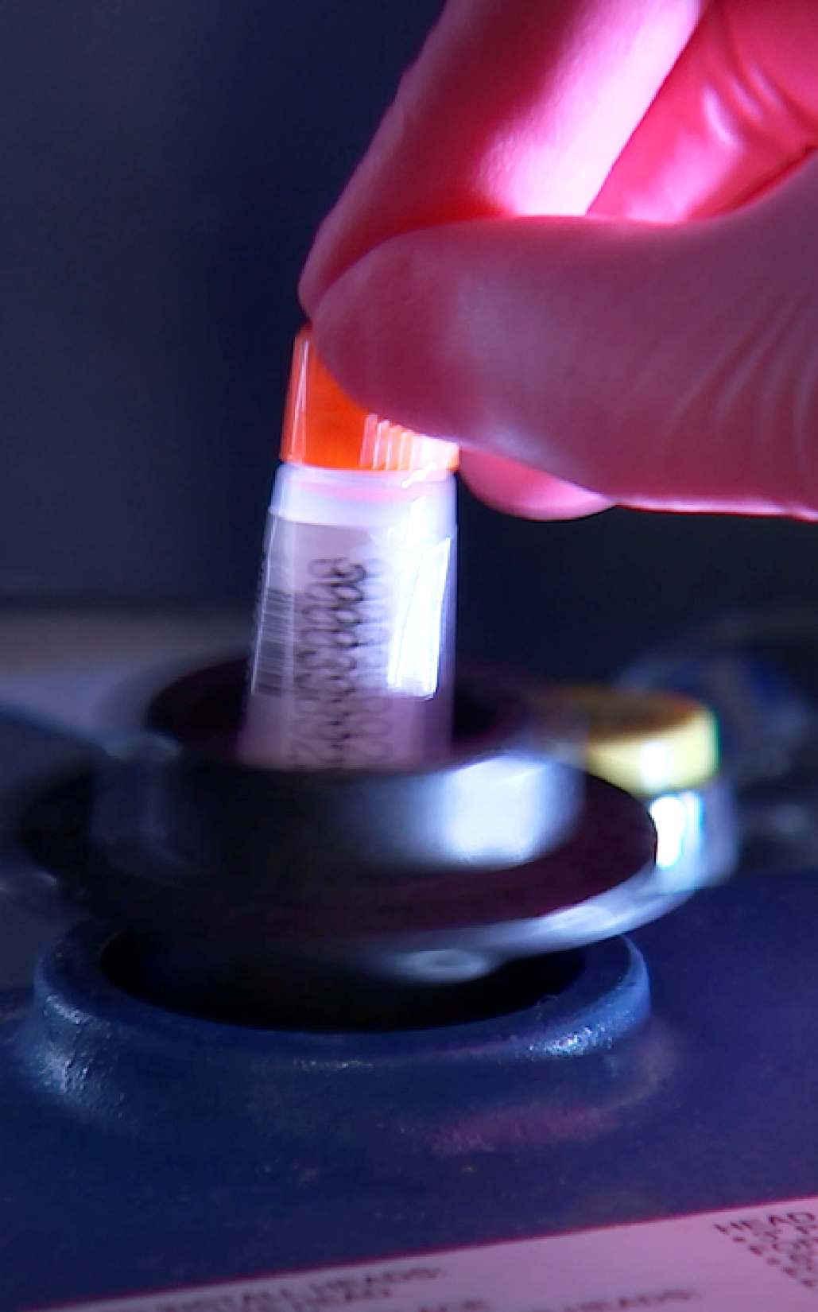
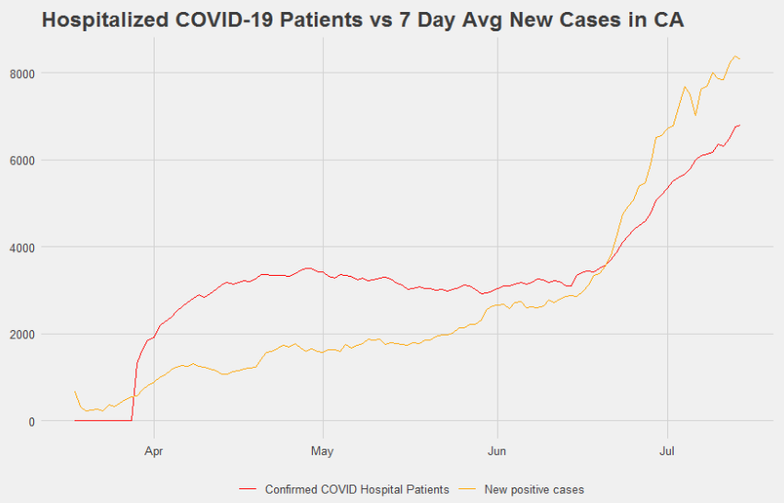
California

Slide 12
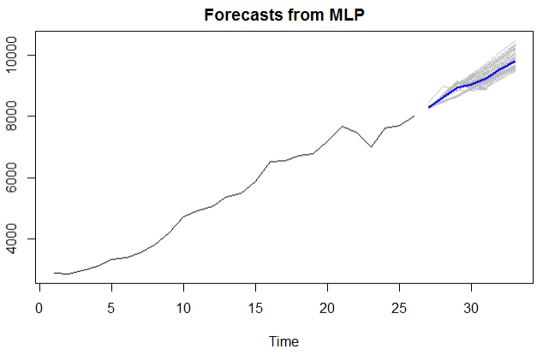
california
Forecast of New Positive Cases (Avg of last 7 Days) - For Use in Multivariate forecasts of Currently Hospitalized Patients

Slide 13

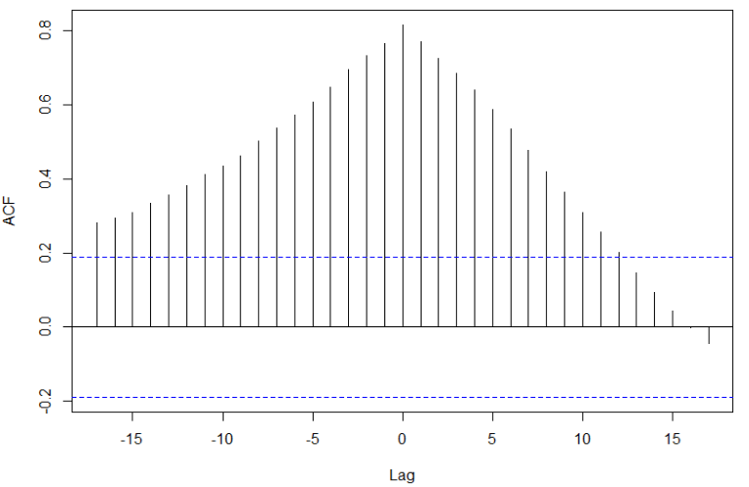
California
MLR Candidate Model

Slide 14
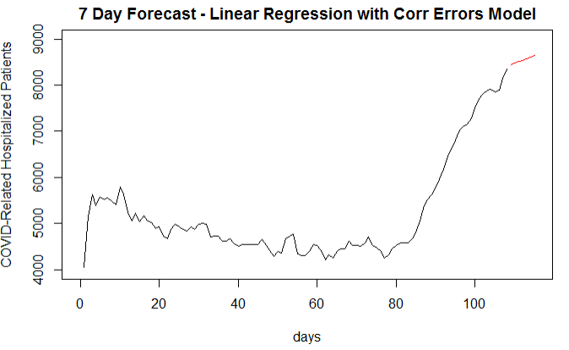
California
MLR Candidate Model
7-Day ASE
173,607
AIC w/o trend: 1,436
AIC with Trend: 1,433

Slide 15
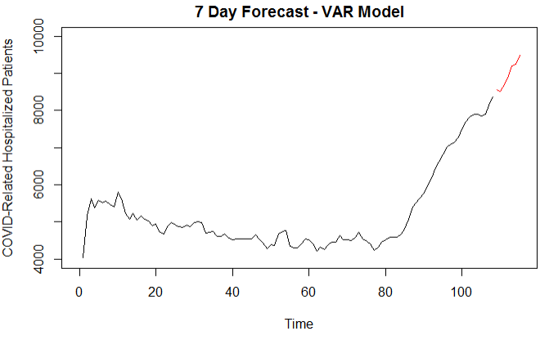
California
VAR Candidate Model
7-Day ASE
1,240,595

Slide 16
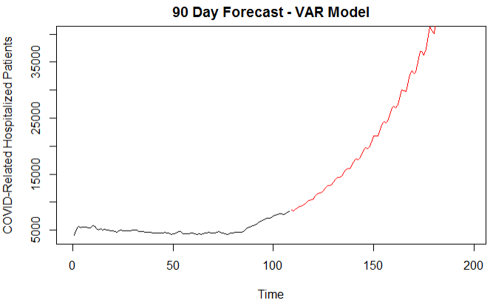
California
VAR Candidate Model

Slide 17
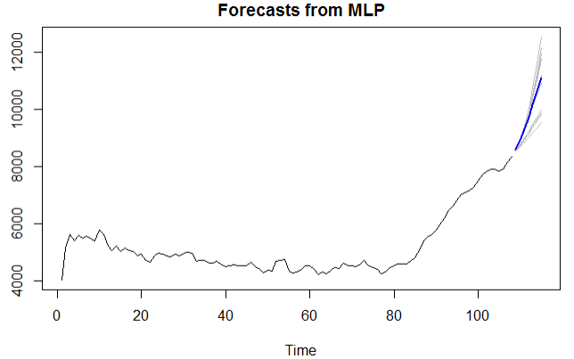
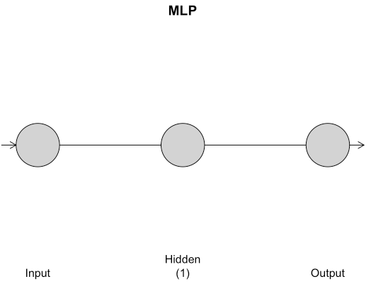
california
Multivariate MLP Candidate Model
7-Day ASE
272,510

Slide 18
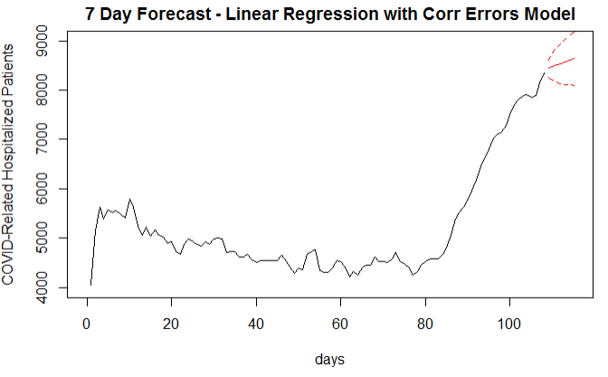
california
Final Models and Conclusions - 7 Day Forecast
HospPatients_{t}= .079(7DayAvgNewCases) + 31.92(Time) + Z_{t}
Z_{t} = (1 - .974B)(X_{t}- 4722) = (1 - .317B)a_{t} wnv est = 29,525

Slide 19
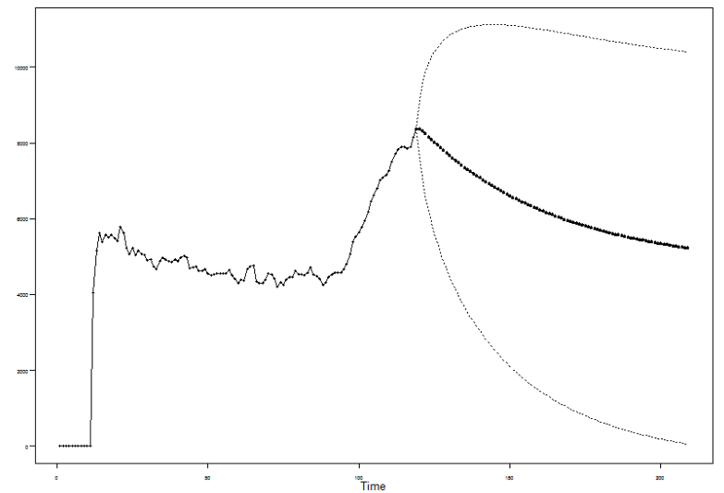
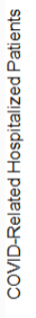
california
Final Models and Conclusions - 90 Day Forecast - ARMA(1, 2)
(1 - .977B)(X_{t}- 4722) = (1 - .009B2 - .008B)a_{t} wnv est = 151635

Slide 20
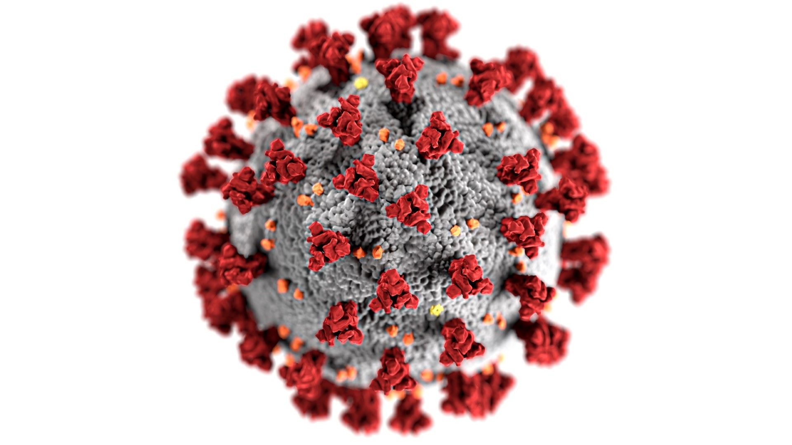
Complete codebooks can be found on our Github.
#covid19

